Slide 1
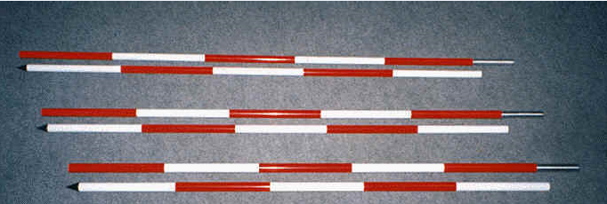
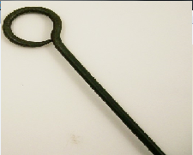
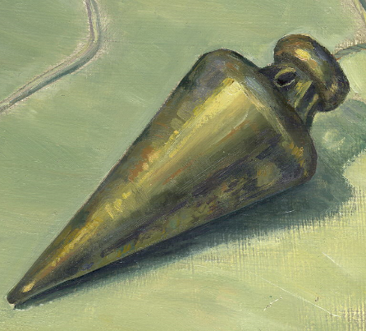
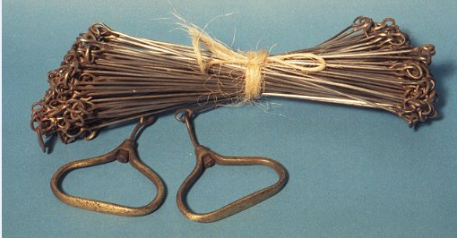
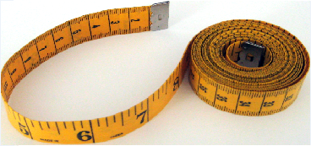
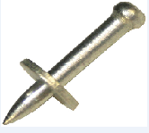

Slide 2
Group-3
1) Jay shah
2) Shivang bhatia
3) Varun patel
4) Mehul jain
5) Sheladiya Chintankumar
6) Parmar jaydeep
Created by jay shah

Slide 4
Terms related to linear measurements

Slide 5
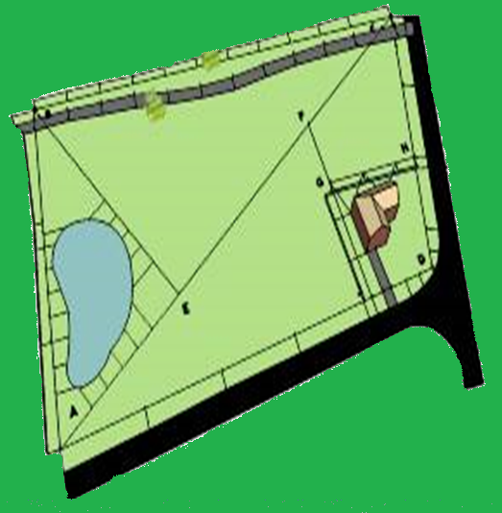
Check line:-
The line joining the apex point of a triangle to some fixed points on its base is chain line.
Tie line:-
A line joining tie stations is termed as a tie line.
Base line:-
The line on which the framework of the survey is built is known as Base line.
Tie line
Check line
Base line
Main survey lines:-
The lines joining the main stations are called “main survey lines” or chain lines.
Main survey line

Slide 6
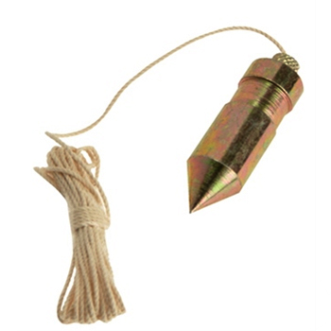
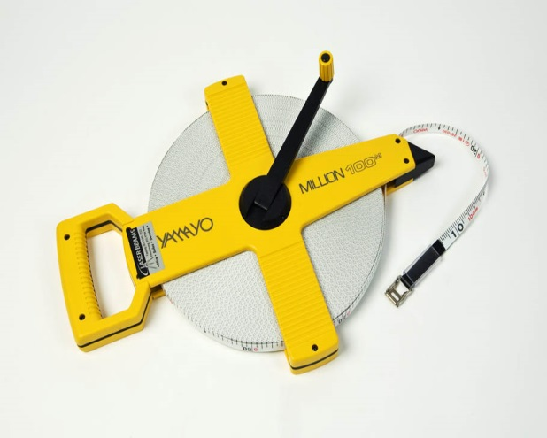
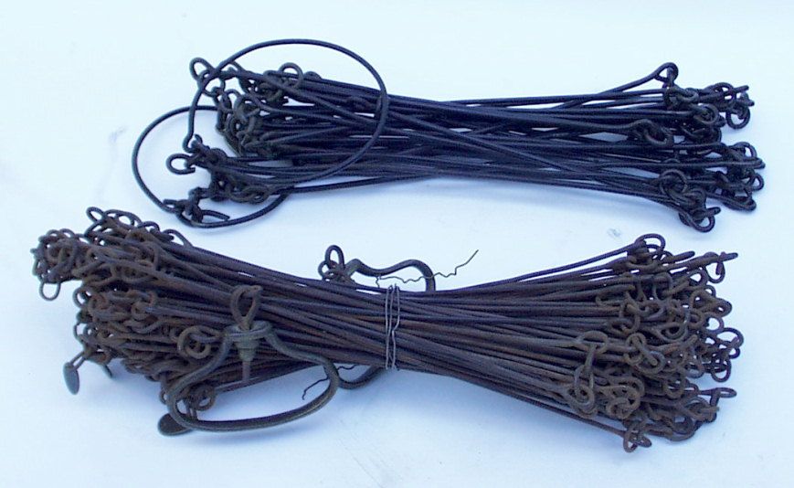
Instruments for chaining
1) Chains 2) Ranging and Offset rods
3) Arrows 4) tapes
5) Pegs 6) Plumb bob
7) Plasterer‘s lath and Whites

Slide 7
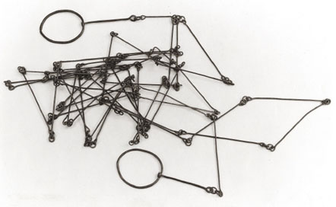
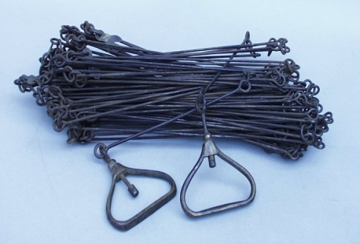
Chains
Metric chain
Revenue chain
Gunter’s chain or Surveyor’s chain
Engineer’s chain
Steel band or band chain

Slide 8
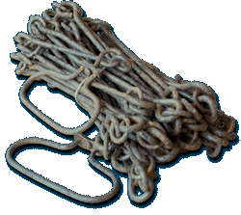
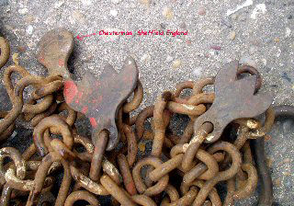
Metric chains are available in lengths of 20m and 30m. The 20 m chain is divided into 100 links , each of 0.2 m. Tallies are provided at every 10 links (2m). The 30 m chain is divided into 150 links. So, each link is 0.2m . The tallies are provided after every 25linls (5m). This chain is suitable for measuring distances along fairly level ground.
Metric Chain

Slide 9
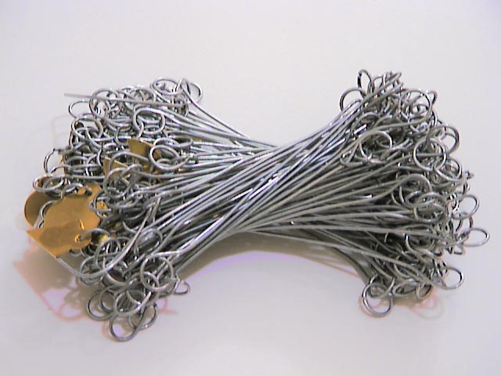
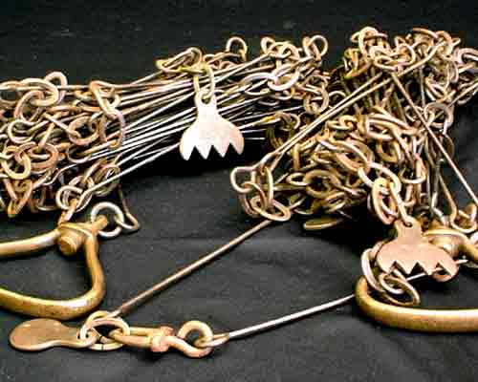
The engineer’s chain is 100 ft. long. It consists od 100 links being 1 ft. long . at every 10 links tallies are kept. The distances measured are recorded in feet and decimals.
Gunter’s chain
It is 66 ft. long and divided into 100 links. So ,each link is of 0.66 ft.
It was previously used for measuring distances in miles and furlongs.
10 Gunter’s chain = 1 furlong and 80 Gunter’s chains = 1 mile
10 square chains are equal to 1 acre.
Engineer’s chain

Slide 10
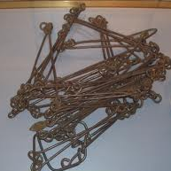
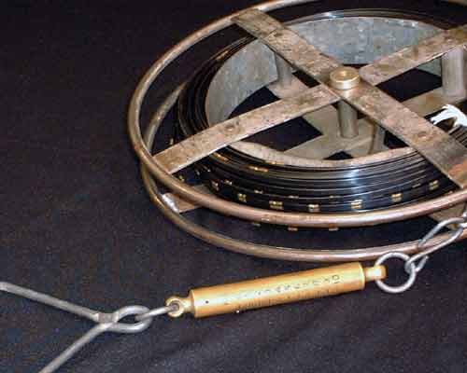
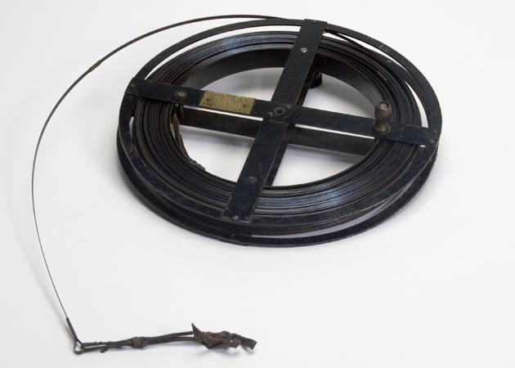
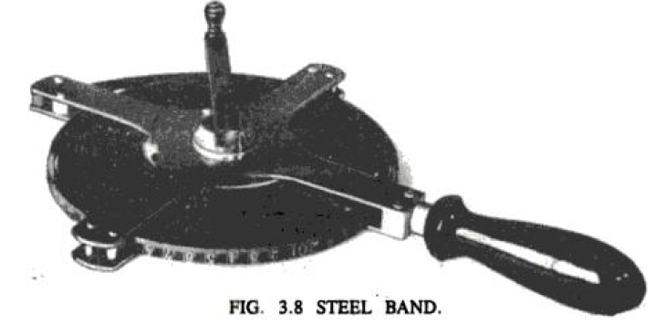
The revenue chain is 33 ft. long and divided into 16 links. It is mainly used in cadastral survey. Used to measure small distances in feet's and inches.
Revenue chain
Steel band chain
It consists of a ribbon of steel of width 16 mm and length 20 or 30 m.
It has a brass handle at each .
It is graduated in meters , decimeters , and centimeter on
one side and has 0.2 m link on other.
The steel band is used in projects where more accuracy is required.

Slide 11
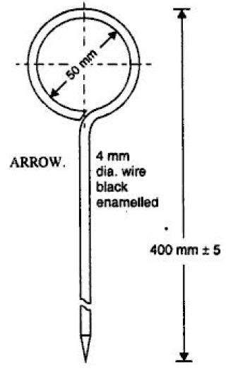
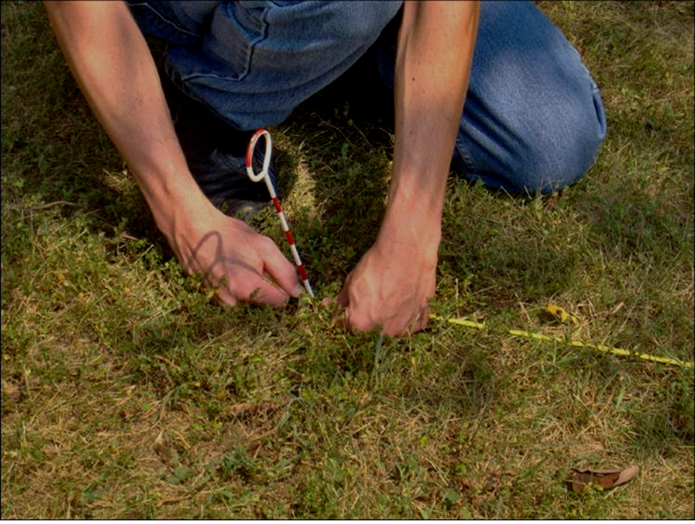
ARROWS
Arrows or marking pins
Arrows:-
Arrows are made of tempered steel wire of diameter 4 mm. one end of the arrow is bent into a ring of diameter 50 mm and the other end is pointed. Its overall length is 400 mm.
Arrows are used for counting the number of chains used while measuring a chain line.

Slide 12
Pegs
Wooden pegs are used to mark the positions of the stations or terminal points of a survey line.
They are made of stout timber, generally 2.5 cm or 3 cm square and 15 cm long , tapered at the end.
They are driven in the ground with the help of a wooden hammer and kept about 4 cm projecting above the surface.

Slide 13
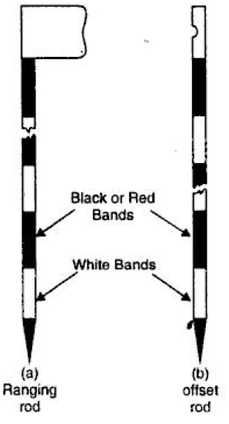
They are painted with black and white or red and white colors with length of each equalizing 20 cm. The location of any survey station can be known from long distances only by means of ranging rods. If the distance is too long, a rod of length 4 to 6 m is used and is called ranging pole. The offset rods are same as ranging rods but instead of the flag, a hook is provided at top for pushing or pulling the chain. It is used for measuring small offsets.
Ranging rods and
Offset rods
Ranging rods have a length of either 2 m or 3 m, the 2 m length being more common.
Ranging rods

Slide 14
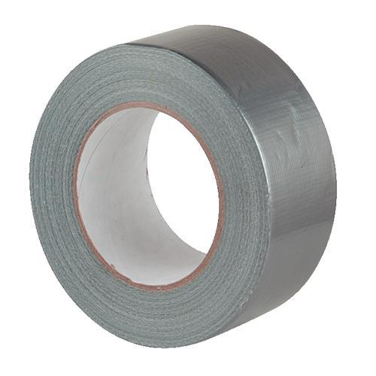
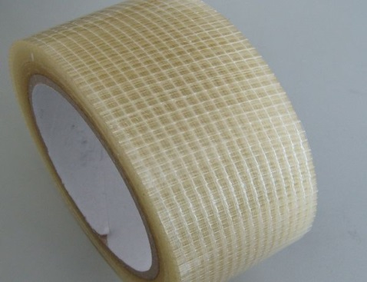
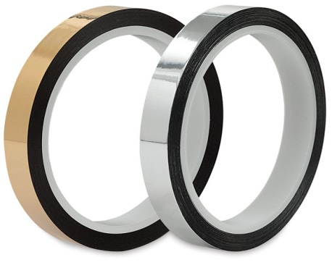
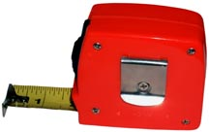
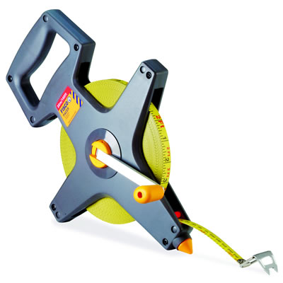
Fiber tape
Metallic tape
Steel tape
Invar tape
Cloth or Linen tape
Tapes

Slide 15
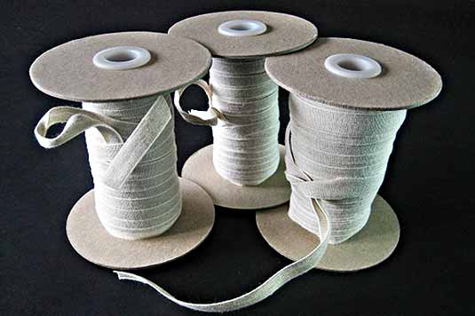
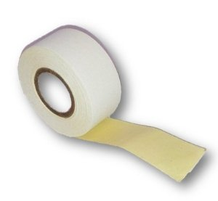
Cloth or linen Tape:
Such a tape is made of closely woven
linen and is varnished to
resist moisture.
It is 15 mm wide and available
in lengths of 10 and 15 m.
This is generally used for measuring
offsets and for ordinary works.
Metallic Tape:
When linen tape is rein forced with brass
or copper wires to make it durable,
then it is called a metallic tape.
This tape is available in lengths of 15, 20 and 30 m.
It is wound on a leather case with a brass handle at the end.
It is commonly used for all survey works.

Slide 16
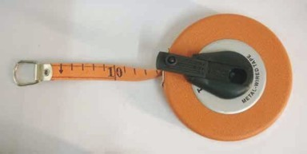
Invar Tapes:
They are made of an alloy of steel (64%) and nickel (36%).
Its thermal coefficient is very low. Therefore, it is not affected by change of temperature. It is made in the form of a ribbon of width 6 mm and is available required. It is generally used in the triangulation survey conducted by the Survey of India Department.

Slide 17
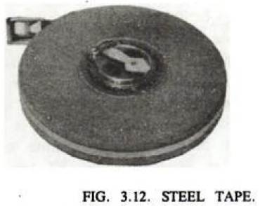
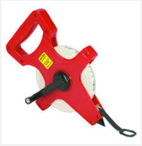
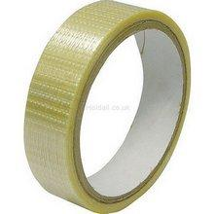
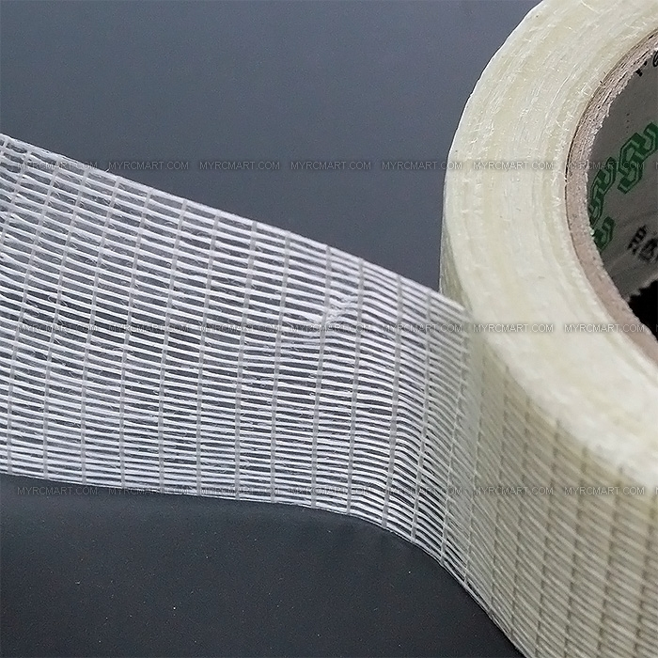
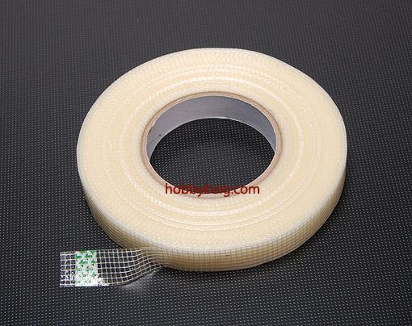
Fiber Tapes
Steel tape:
The steel tape is made of steel ribbon of width varying from 6 to 16 mm.
The commonly available lengths are 10, 15 ,20 ,30 and 50 m.
It is graduated in meters, decimeters and centimeters. It is not used in the field but chiefly for standard sing chains and for measurements in constructional works.
These tapes are made of glass fiber.
The tapes are quite flexible, strong and non-conductive.
These tapes are available in lengths of 20 m , 30m, and 50m lengths.
These tapes are used even in vicinity of electrical equipment's.

Slide 18
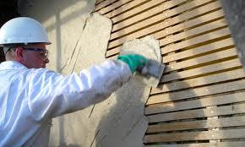
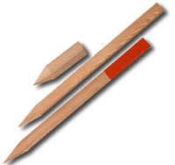
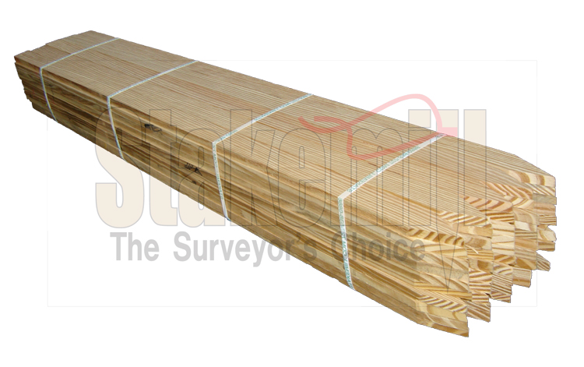
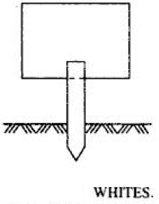
Plasterer’s laths and whites
Plasterer’s laths
In open level ground, intermediate points on a line may be lined out with straight laths, 0.5 to 1 m long, made of soft wood.
They are light both in color and weight, and can be easily carried about and sharpened with a knife when required. They are also very useful for ranging out a line when crossing a depression from which the forward rod is invisible, or when it is hidden by obstacles, such as hedges etc.
WHITES
Whites are pieces of sharpened thin sticks cut from the nearest edge, and are used for the same purpose as the laths, though not so satisfactory in use. They are sharpened at one end and split with the knife at the top, and pieces of white paper are inserted in the clefts in order to make them more visible when stuck up in the grass. They are also useful in cross-sectioning of the field.

Slide 19
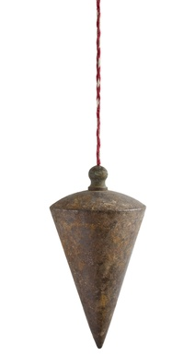
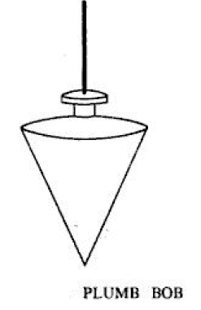
PLUMB BOB
PLUMB-BOB
While chaining along sloping ground, a plumb-bob is required to transfer the points on the ground.
It is also used to make ranging poles vertical and to transfer points from a line ranger to the ground.
In addition, it is used as centering aid in theodolites, compass, plane table and a variety of other surveying instruments.

Slide 20
Click on arrow for video
Linear measurement
video

Slide 21
Sources

Slide 22
By :- Jay shah Civil-A
group-3

